Slide 1


WORKSHOP PROJECT
2HA NEWS(NEWS WEBSITE)
ANSHUL KUMAR RAWAT
HIMANSHU DWIVEDI
AADITYA ASTHANA
HARSH GUPTA

Slide 2
INTRODUCTION
2HA news is website where the entire news of the globe is available
1
additional feature like flight booking , travel, COVID-19 live status, live currency update ,etc make it more user friendly
2
viewers can do both read news or view it from live tv channels on same platform
3
no private details are required for surfing the site
4
interactive design with the use of html5 , CSS , java script and some useful widgets
5

Slide 3

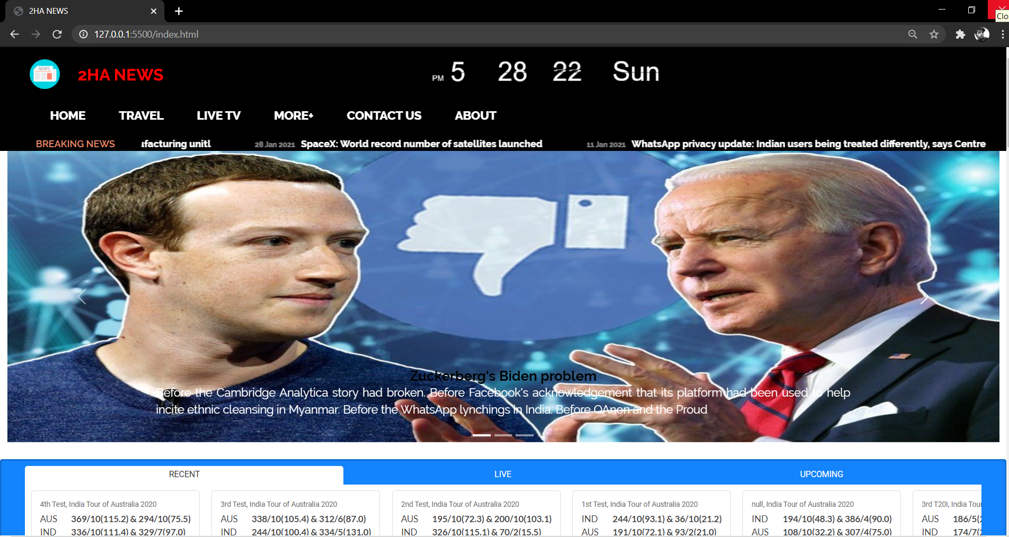
SCOPE
1
2
3
4
easy to access and user friendly
no doubt India is one of the fastest developing country therefore t is necessary for citizens to be UpToDate
For made in India program, market related information and political update are required
.
ease for people to avoid fake news as every thing is available on same platform
.

Slide 4
OBJECTIVE
1
2
3
4
the main objective is too provide all types of news like business, sports , medical etc
people having busy Schedule can easily get news update in less time with there accordance
detailing option for head lines so that more number of news on same page makes it easy to fetch and user friendly
.
people can easily get UpToDate news

Slide 5
Developer Side Requirements:
HARDWARE REQUIREMENTS:
RAM : 4 GB RAM
Processor : Intel Atom® processor or Intel® Core™ i3 processor Disk space: 10 GB free disk space
2. SOFTWARE REQUIRENTS:
Operating System: Windows, LINUX, MAC, etc
Front End: HTML5, CSS, JavaScript
Software: Visual studio code, notepad++

Slide 6
User Side Requirements:
HARDWARE REQUIREMENTS:
RAM : 2 GB RAM
Processor : Intel Atom® processor or Intel® Core™ i3 processor
2. SOFTWARE REQUIRENTS:
Operating System: Windows, LINUX, MAC, etc
Browser: chrome, safari, edge, opera,etc
.net framework 3.0 or higher.

Slide 7
FEATURES
.

Slide 8
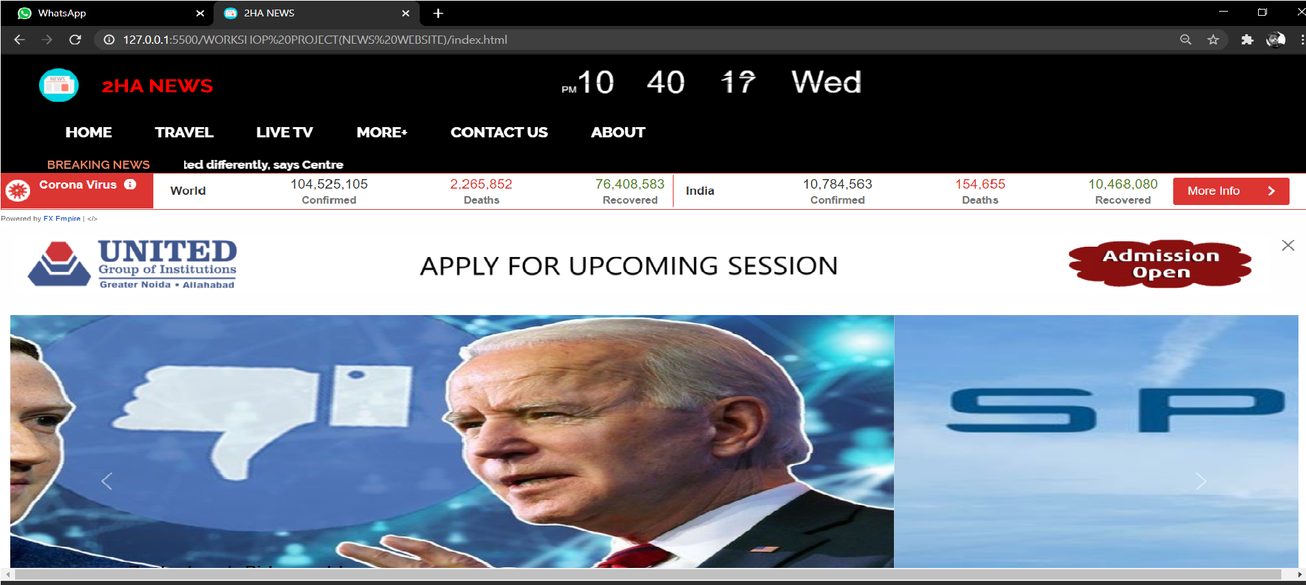
HOME PAGE
Homepage contains real time, live corona updates and breaking news

Slide 9
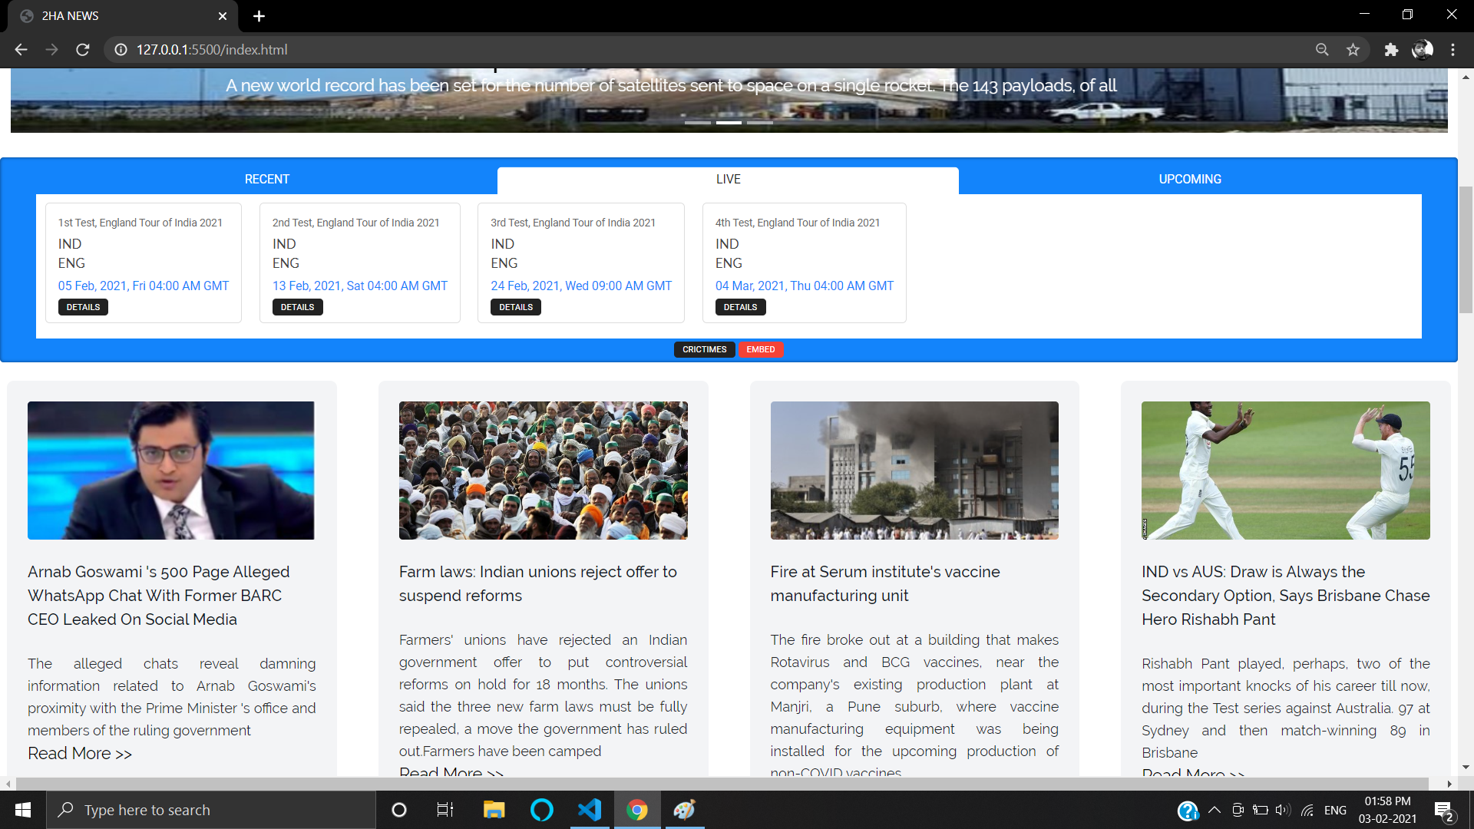
HOME PAGE
Homepage contains score of match with there live status , big trending story

Slide 10
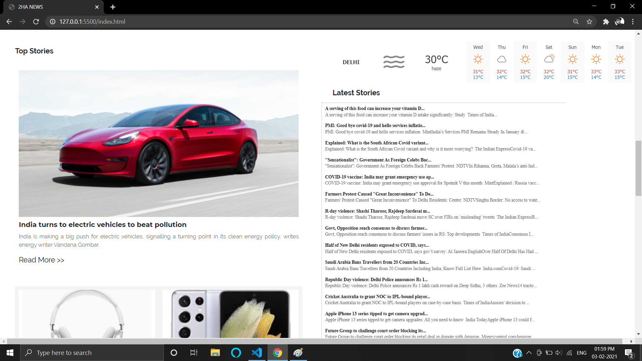
HOME PAGE
dedicated corner for tech word, live weather update and list of latest news get updated every few seconds

Slide 11
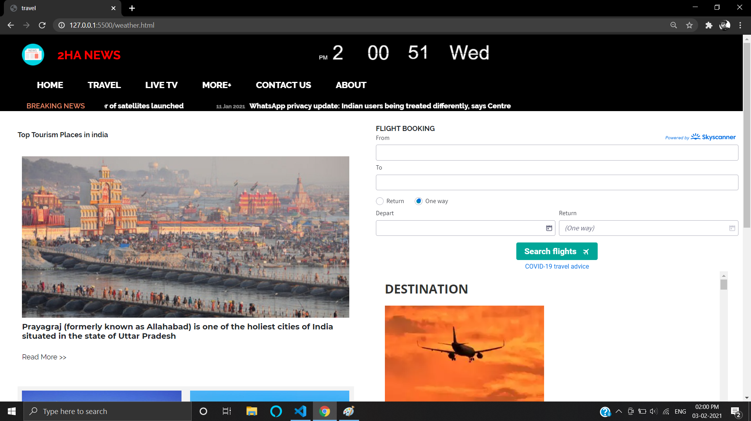
TRAVEL SECTION
special section for travelers , having flight booking system and advisory for travelling by respective governmental authorities

Slide 12
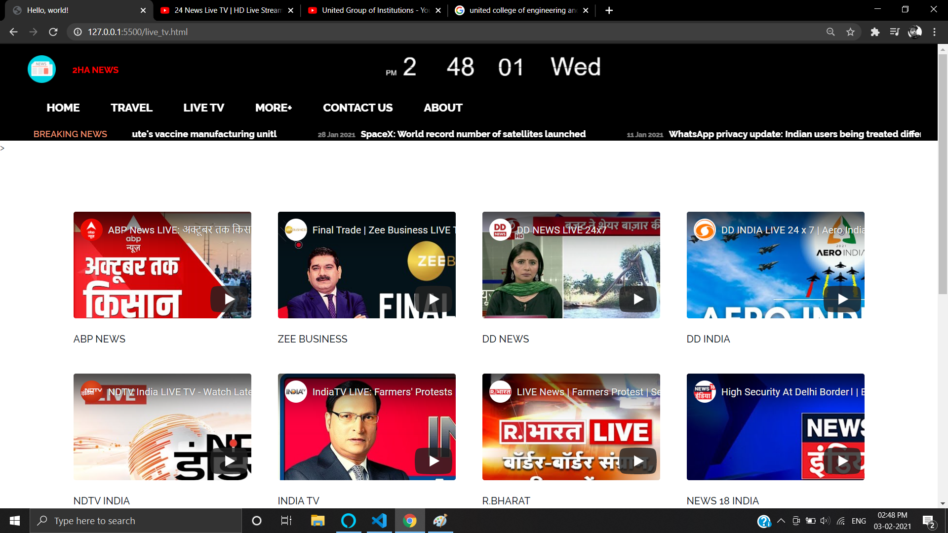
LIVE TV SECTION
free access to reputed live news channels in your native languages

Slide 13
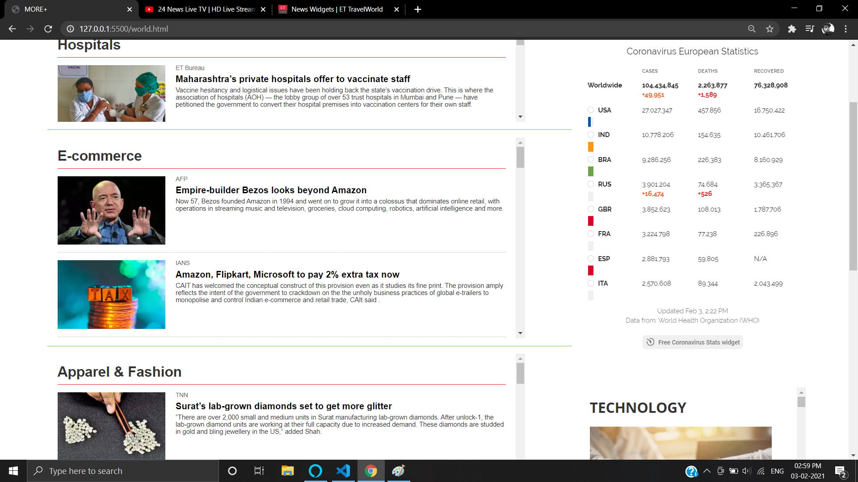
MORE+ SECTION
more+ section contains section related news like hospitals , e-commerce etc. and also contains world corona updates

Slide 14
1
easy to access anytime, any where
Advantages
2
all news related globe data in one platform
3
real time currency update
4
popular place for traveller
5
easy to book flight in travel section
free access for popular live news channels.
6

Slide 15

FUTURE UPDATES
enhance user interface(UI) and more user friendly.
adding subscribe to our newsletter section for latest news to our viewers via e-mail.
enhancing news categories and try to being true to our users.
adding search box and making it more compatible for user.

Slide 16

THANK YOU

